Slide 1
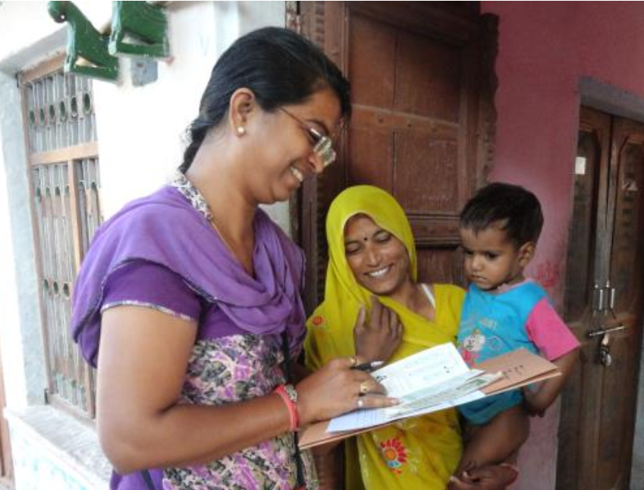
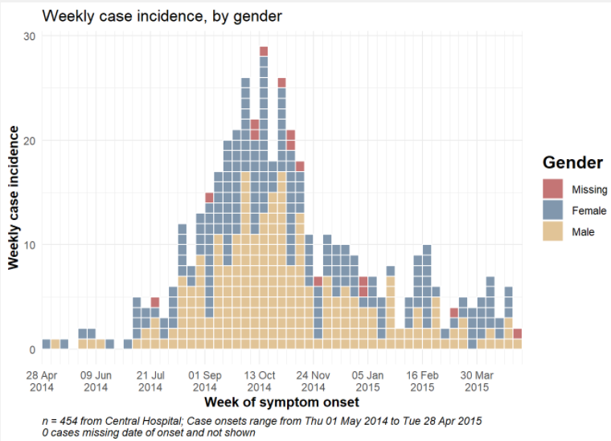
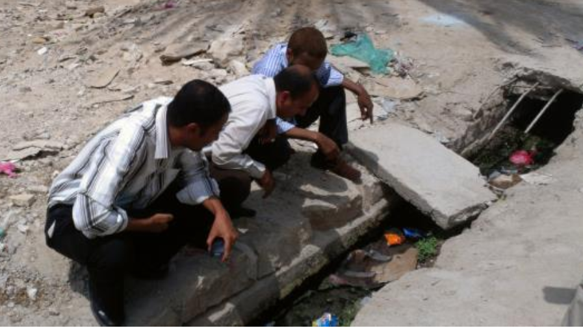
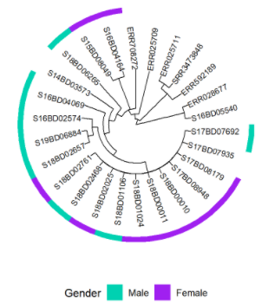
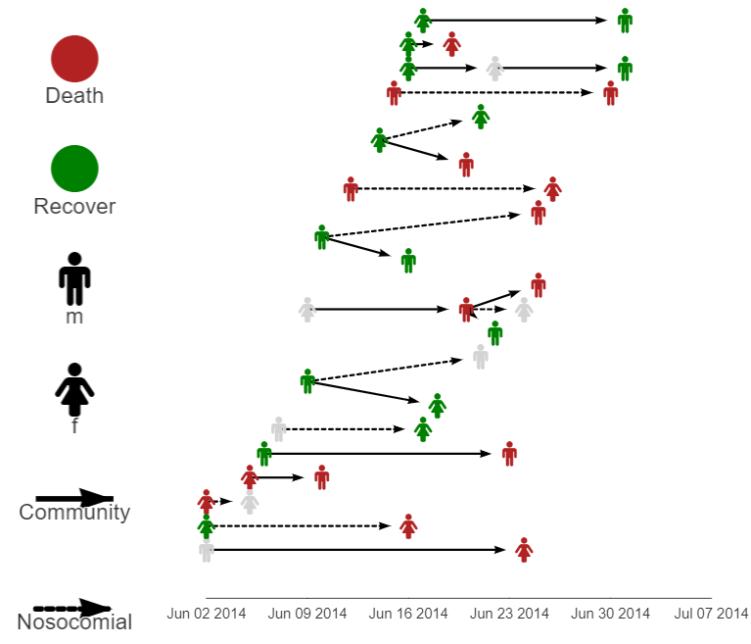
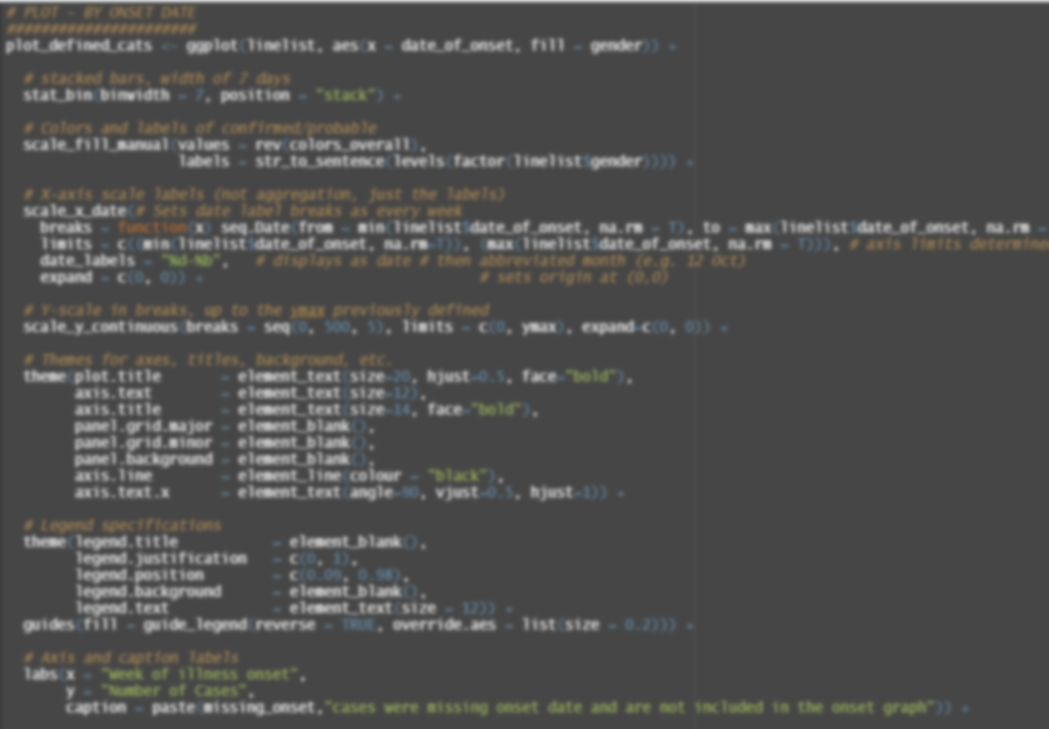
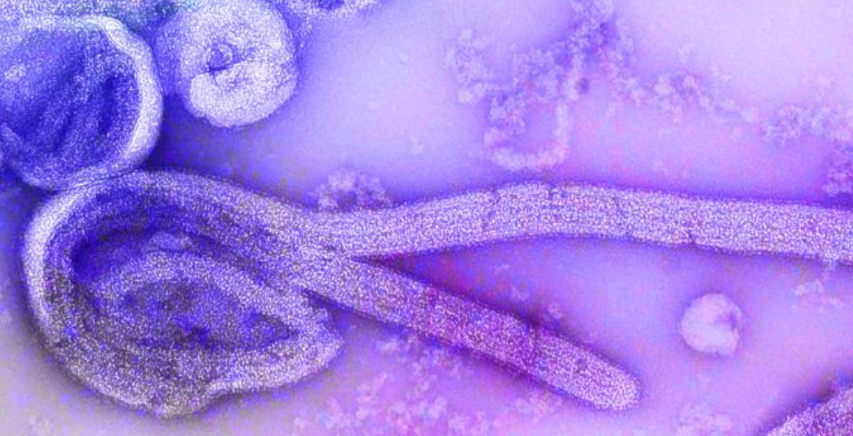
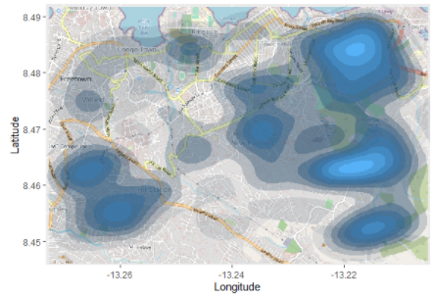
The Epidemiologist
R Handbook

Slide 3

Small logo
R made of connected dots
“A” made from epicurve?
Adventurer holding handbook
R you ready?

Slide 4
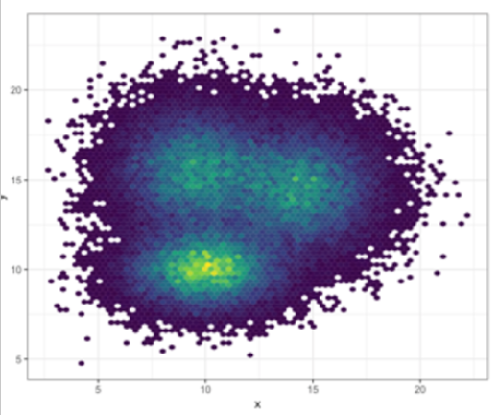
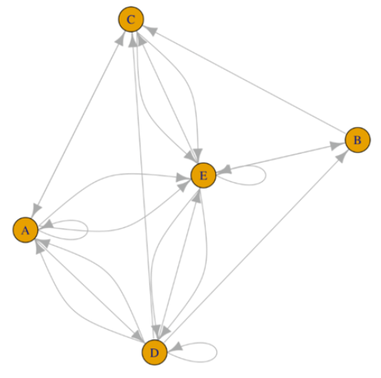
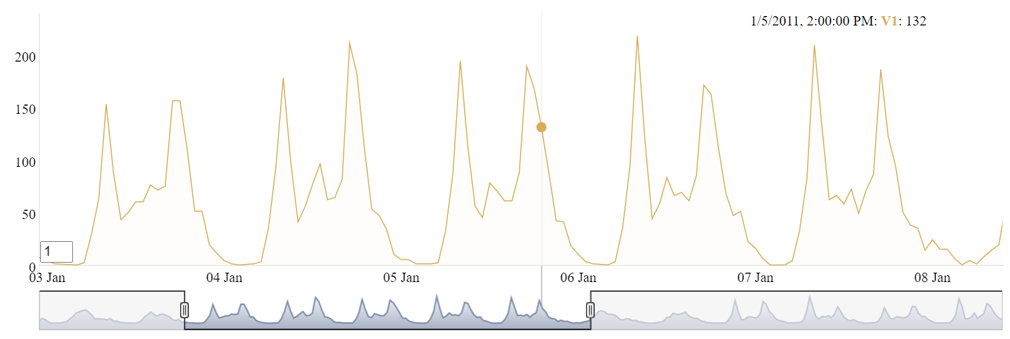
Sources:
2013 Yemen looking for mosquito breeding sites: https://phil.cdc.gov/Details.aspx?pid=19623
Ebola virus: https://phil.cdc.gov/Details.aspx?pid=23186
Survey in Rajasthan: https://phil.cdc.gov/Details.aspx?pid=19838
Network: https://www.r-graph-gallery.com/257-input-formats-for-network-charts.html

Slide 5
Deduplication

Slide 6
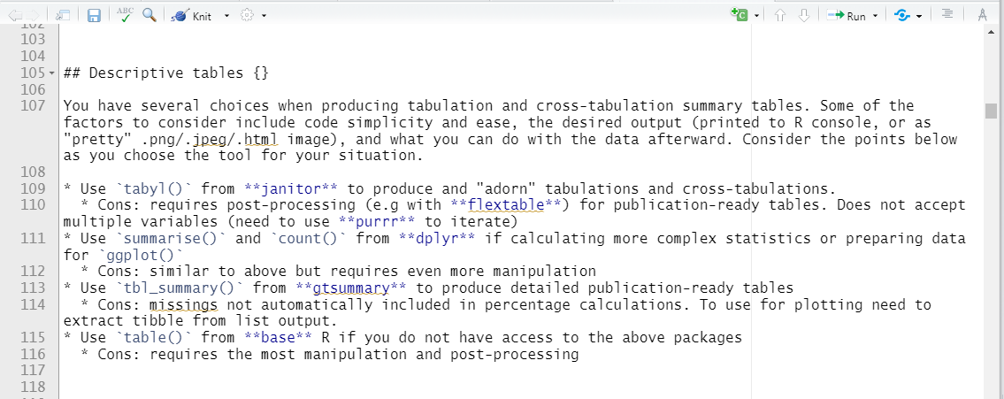
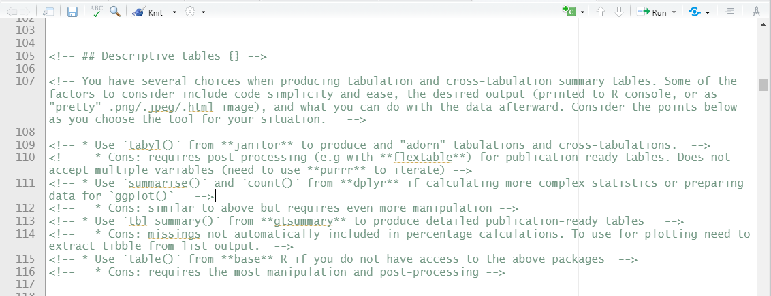
To “comment out” (hide) R Markdown text, highlight and press Ctrl+Shift+c (Windows) or Cmd+Shift+c (Mac)

Slide 7
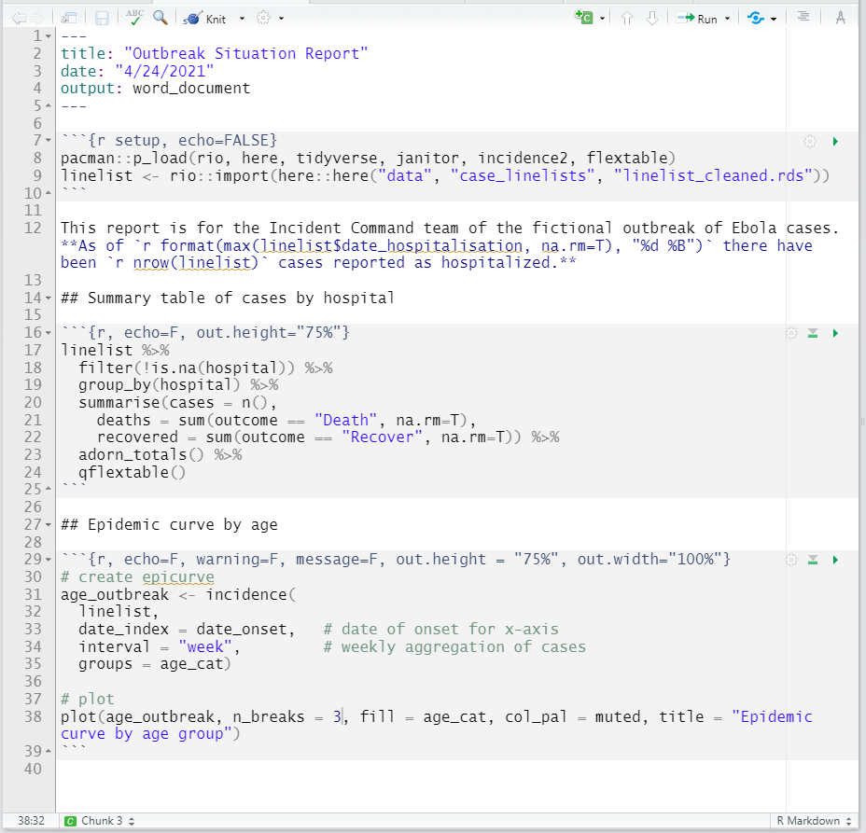
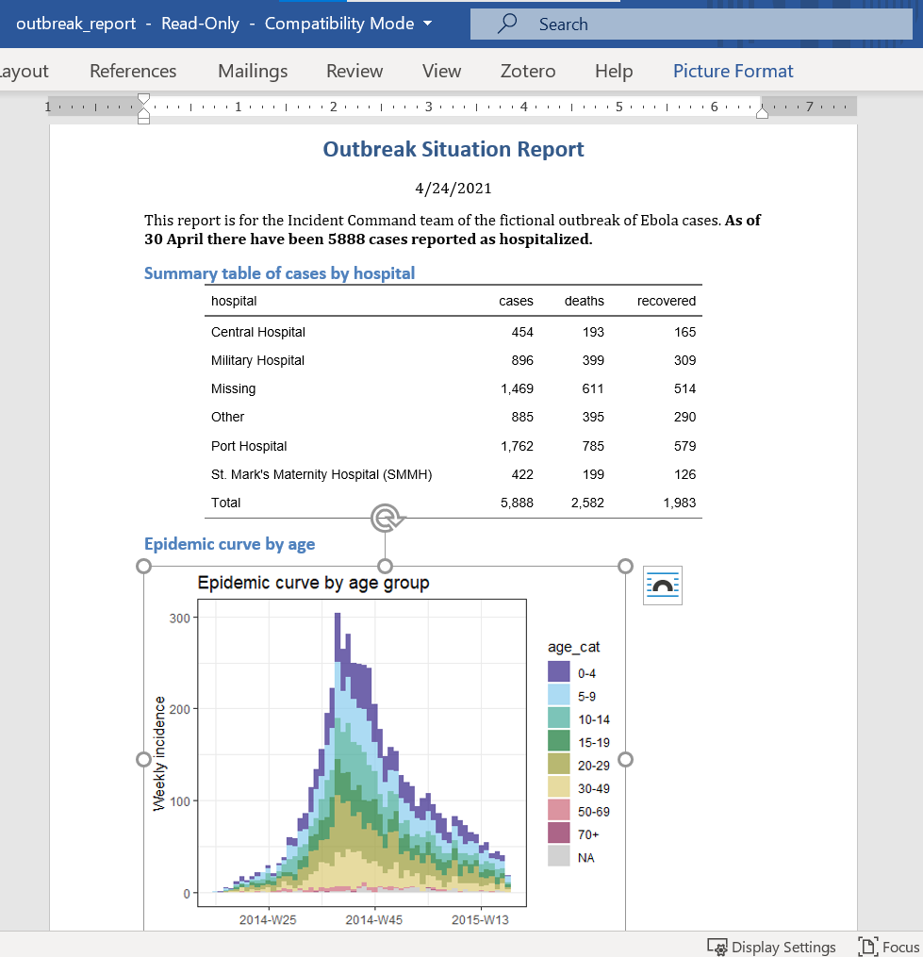
R Markdown script
YAML sets title, date, and output type
Output (e.g. Word document)
Code chunk loads packages and data
Text and in-line code
Code chunk makes table
## Headings
Code chunk makes plot

Slide 8
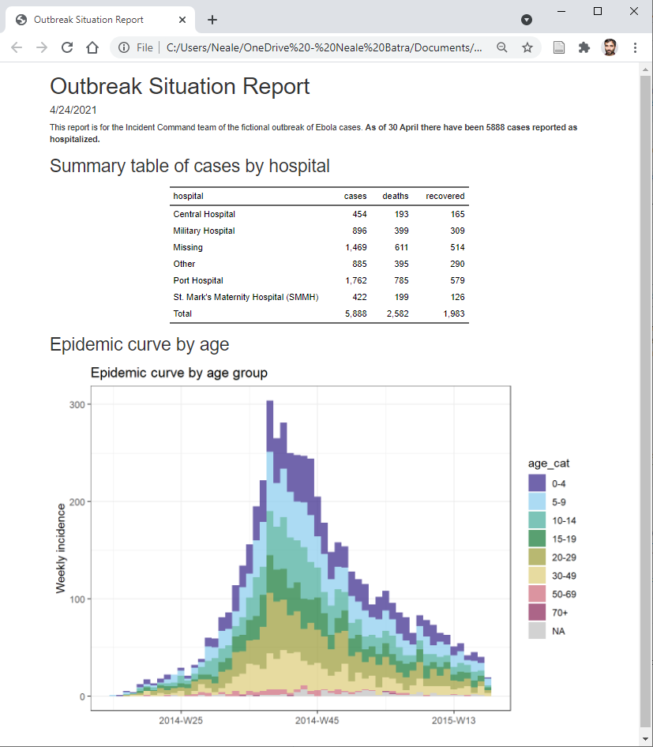

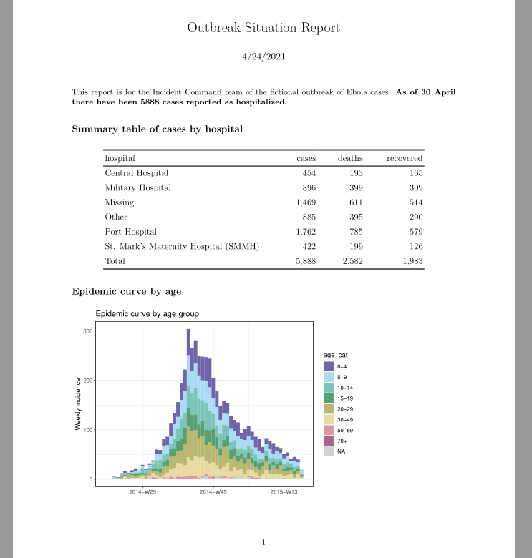
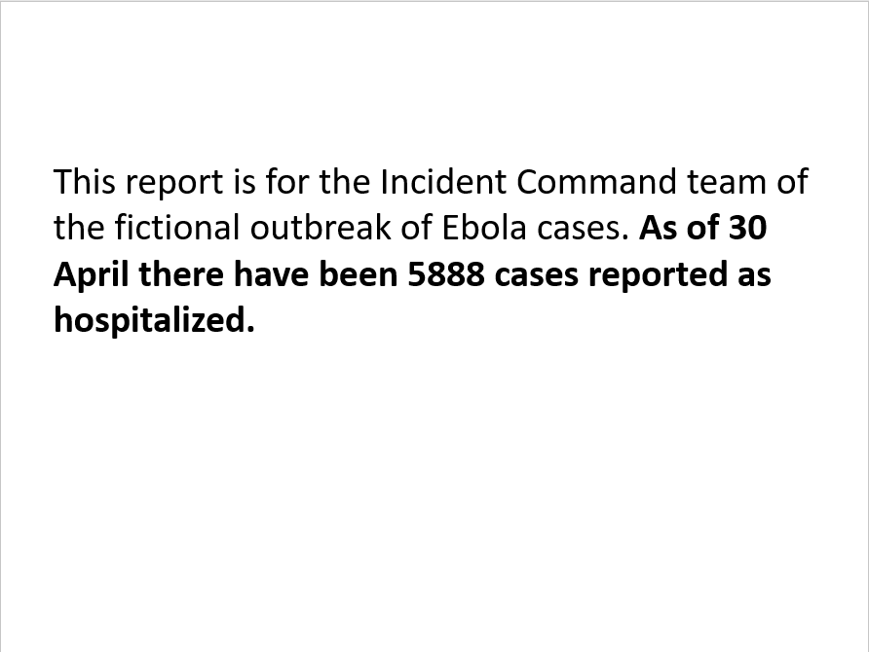
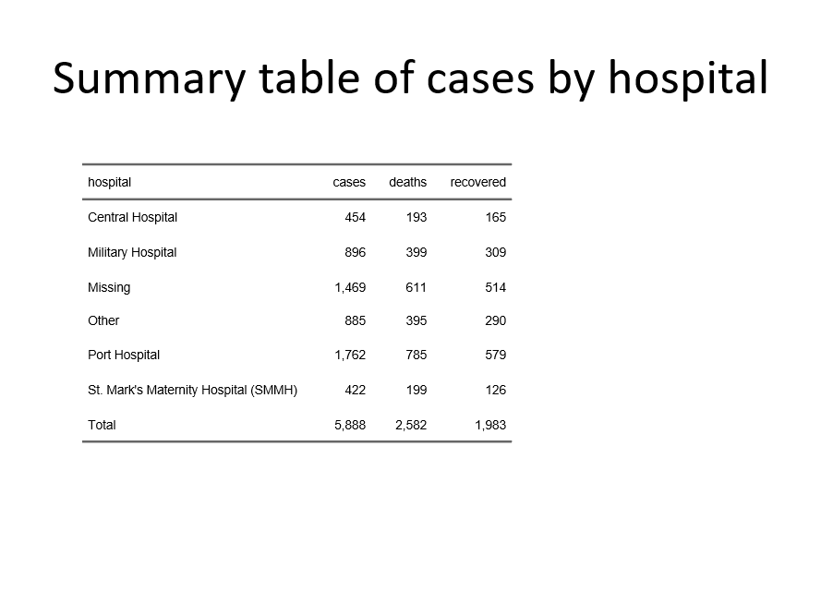
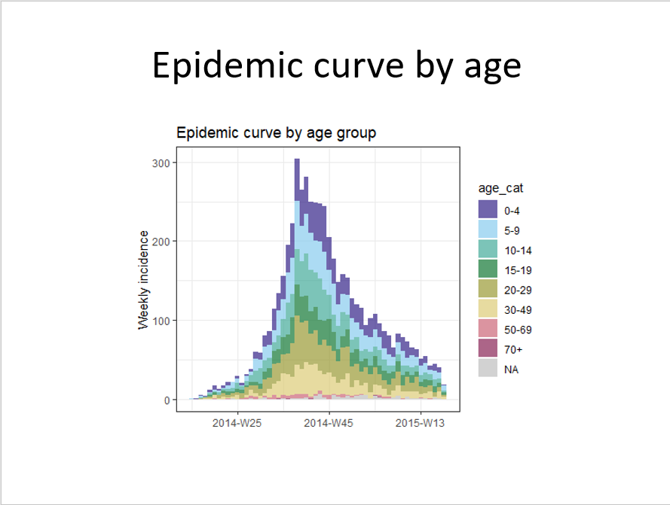
Word
HTML
R Markdown script
Powerpoint
PDF

Slide 9

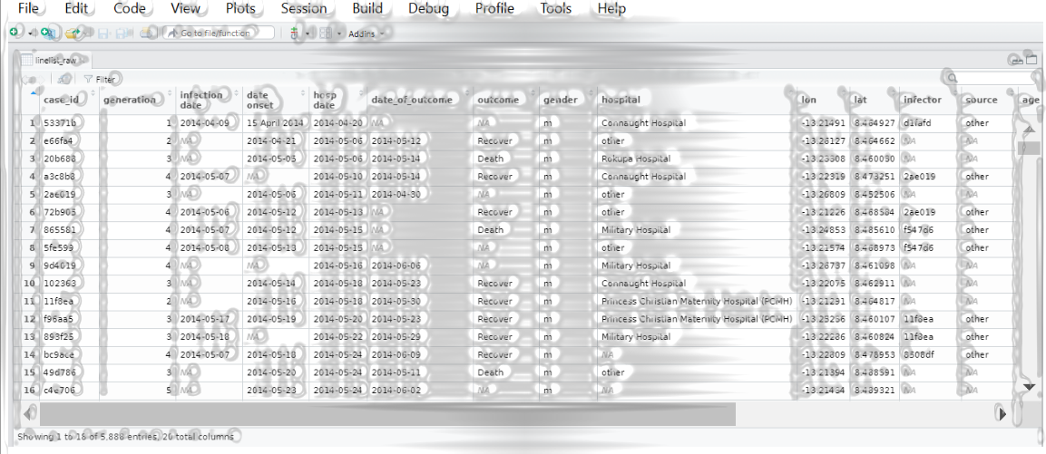
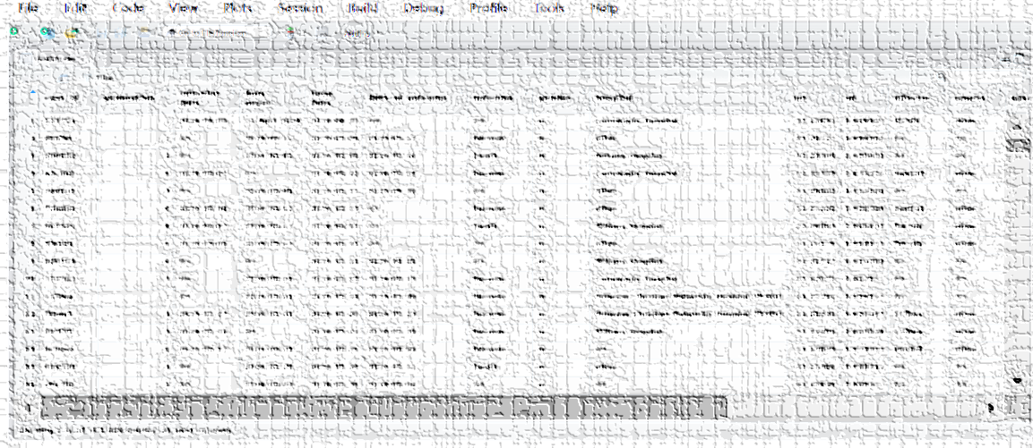
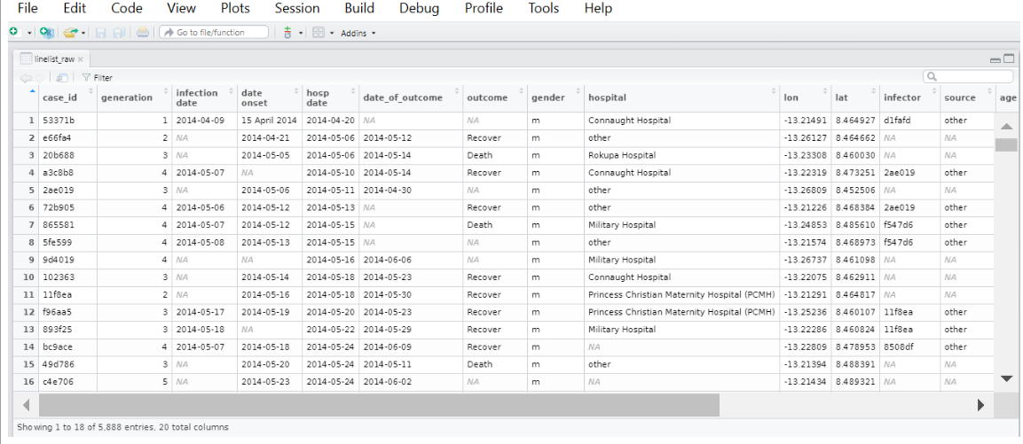

Slide 10
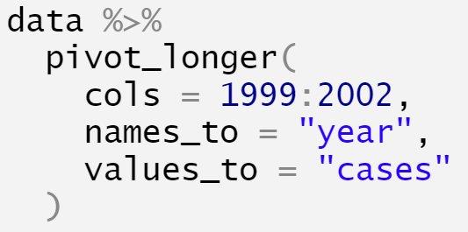
country | 1999 | 2000 | 2001 | 2002
Angola | 800 | 750 | 925 | 1020
India | 20100 | 25650 | 26800 | 27255
Mongolia | 450 | 512 | 510 | 586
country | year | cases
Angola | 1999 | 800
Angola | 2000 | 750
Angola | 2001 | 925
Angola | 2002 | 1020
India | 1999 | 20100
India | 2000 | 25650
India | 2001 | 26800
India | 2002 | 27255
Mongolia | 1999 | 450
Mongolia | 2000 | 512
Mongolia | 2001 | 510
Mongolia | 2002 | 586
Pivot data longer

Slide 11
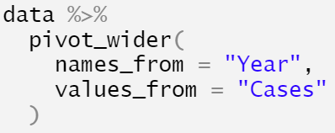
Country | Year | Cases
Angola | 1999 | 800
Angola | 2000 | 750
Angola | 2001 | 925
Angola | 2002 | 1020
India | 1999 | 20100
India | 2000 | 25650
India | 2001 | 26800
India | 2002 | 27255
Mongolia | 1999 | 450
Mongolia | 2000 | 512
Mongolia | 2001 | 510
Mongolia | 2002 | 586
Country | 1999 | 2000 | 2001 | 2002
Angola | 800 | 750 | 925 | 1020
India | 20100 | 25650 | 26800 | 27255
Mongolia | 450 | 512 | 510 | 586
Pivot data wider

Slide 12
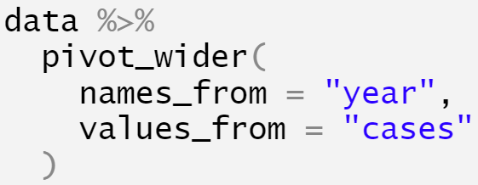
country | year | cases
Angola | 1999 | 800
Angola | 2000 | 750
Angola | 2001 | 925
Angola | 2002 | 1020
India | 1999 | 20100
India | 2000 | 25650
India | 2001 | 26800
India | 2002 | 27255
Mongolia | 1999 | 450
Mongolia | 2000 | 512
Mongolia | 2001 | 510
Mongolia | 2002 | 586
country | 1999 | 2000 | 2001 | 2002
Angola | 800 | 750 | 925 | 1020
India | 20100 | 25650 | 26800 | 27255
Mongolia | 450 | 512 | 510 | 586
Pivot data wider

Slide 13
country | year | cases
Angola | 1999 | 800
Angola | 2000 | 750
Angola | 2001 | 925
Angola | 2002 | 1020
India | 1999 | 20100
India | 2000 | 25650
India | 2001 | 26800
India | 2002 | 27255
Mongolia | 1999 | 450
Mongolia | 2000 | 512
Mongolia | 2001 | 510
Mongolia | 2002 | 586
country | 1999 | 2000 | 2001 | 2002
Angola | 800 | 750 | 925 | 1020
India | 20100 | 25650 | 26800 | 27255
Mongolia | 450 | 512 | 510 | 586

Slide 14
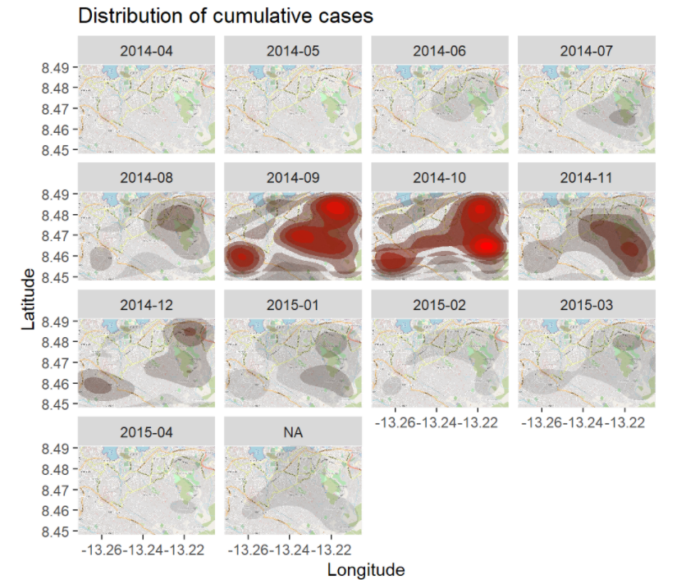
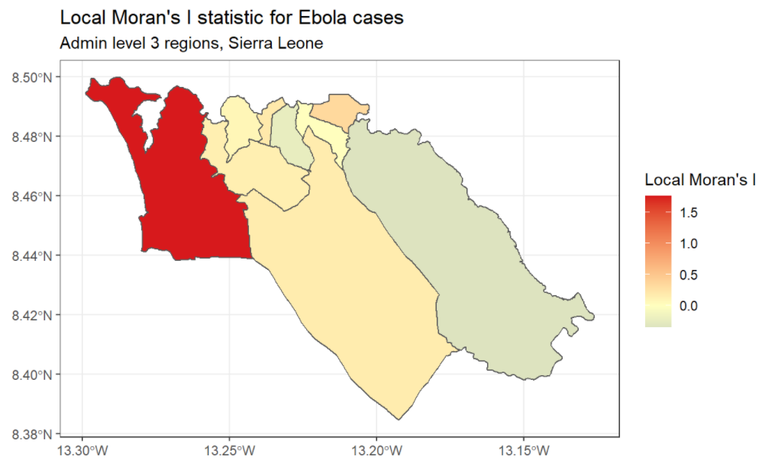
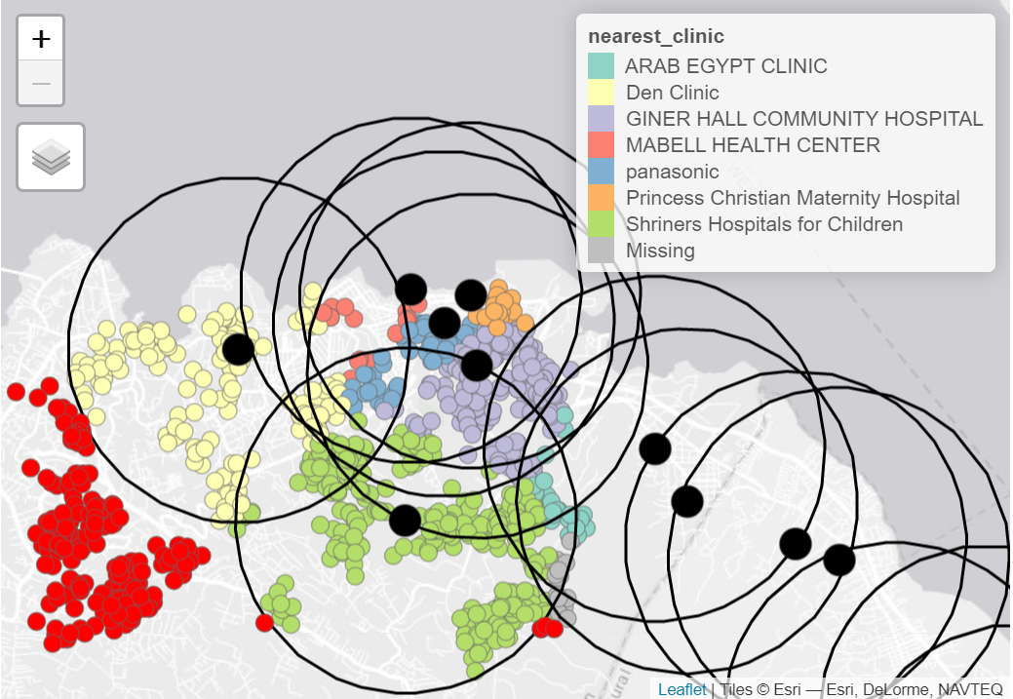
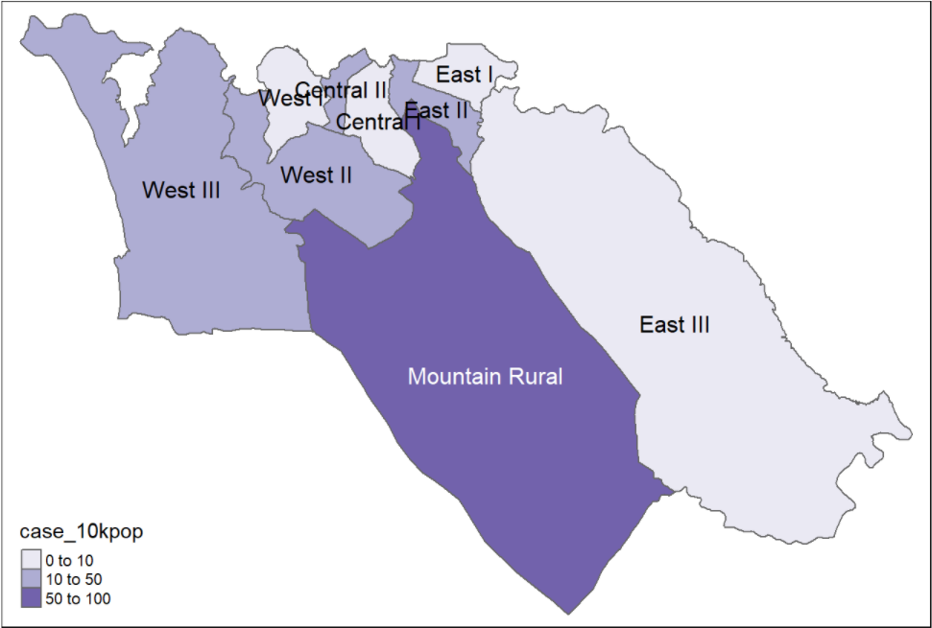

Slide 15
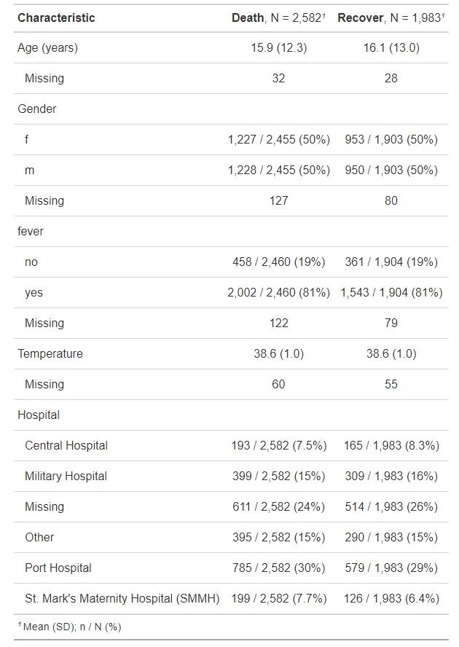
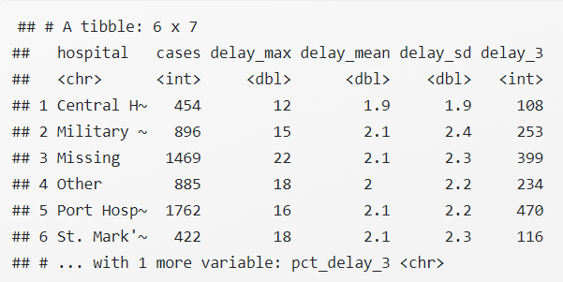
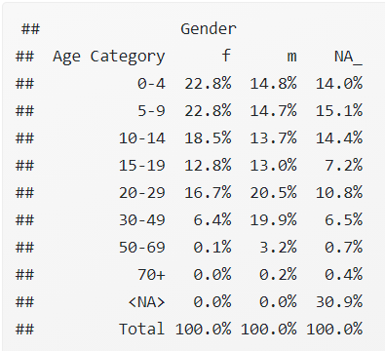

Slide 16

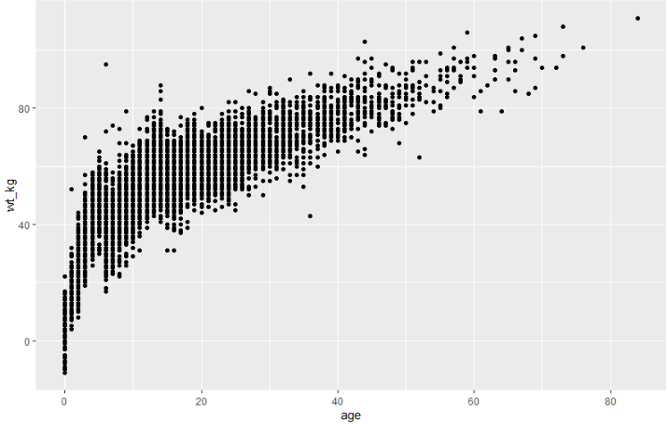
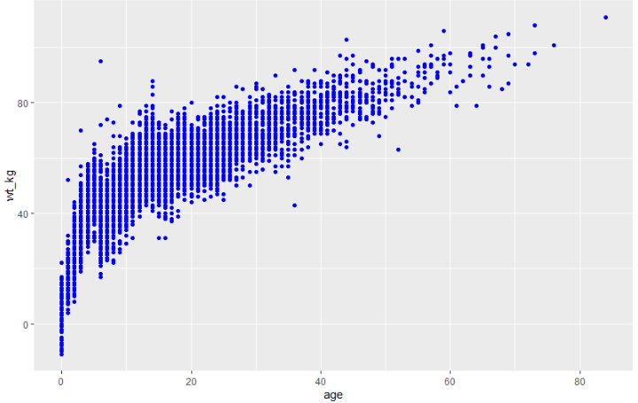
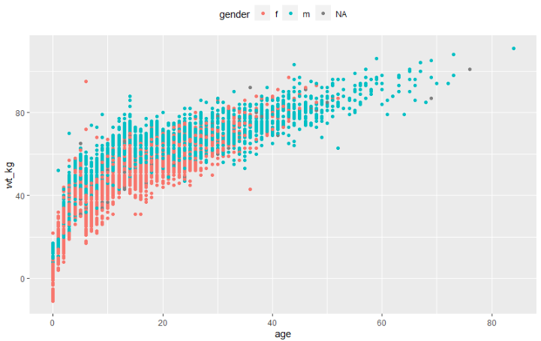
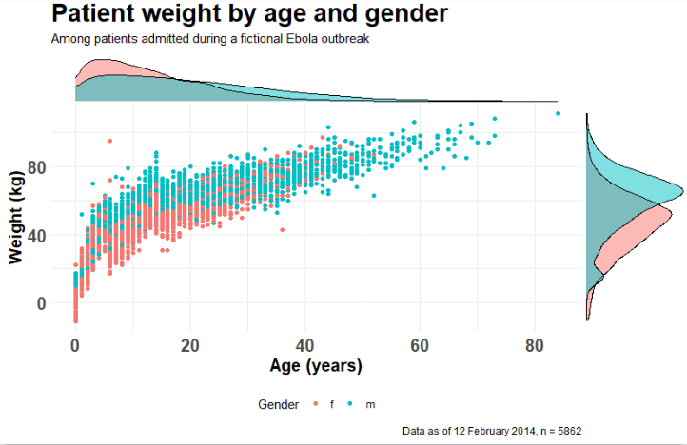

Slide 17
Q1
25th percentile
Median
50th percentile
Q3
75th percentile
Min
Max data point within
Q3 + 1.5 * IQR
Max
Min data point within Q1 – (1.5 * IQR)
Outliers
Outliers
Inter-quartile range (IQR)
1.5 * IQR
1.5 * IQR

